Slide 1
Lustre WAN @ 100GBit Testbed
Michael Kluge
michael.kluge@tu-dresden.de
Robert Henschel, Stephen Simms
{henschel,ssimms}@indiana.edu

Slide 2
Content
Overall Testbed Setup and Hardware
Sub-Project 2 – Parallel File Systems
Peak Bandwidth Setup
LNET – Tests
Details of Small File I/O in the WAN

Slide 3
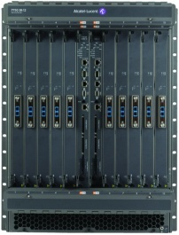
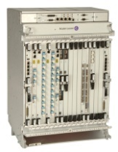
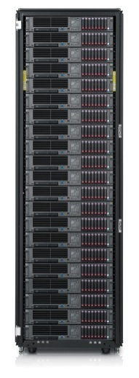
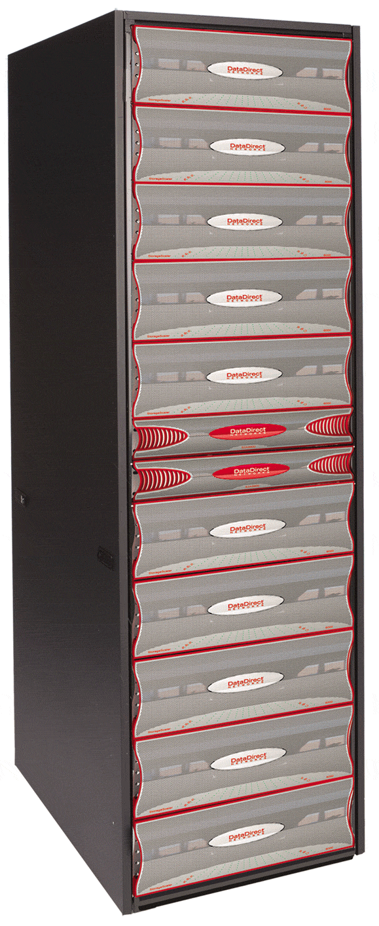
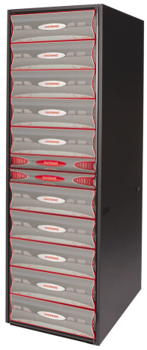
Hardware Setup (1)
100GbE
100GbE
100GBit/s Lambda
60km Dark Fiber
17*10GbE
17*10GbE
16*8 Gbit/s FC
16*8 Gbit/s FC
5*40 Gbit/s QDR IB
16*20 Gbit/s DDR IB

Slide 4
Hardware Setup (2) – File System View
32 Nodes
1 Subnet
100GbE
16*8 Gbit/s
16*8 Gbit/s
5*40 Gbit/s QDR IB
16*20 Gbit/s DDR IB

Slide 5
Hardware-Setup (2) – Bandbreiten unidirektional
12,5 GB/s
100GbE
12,8 GB/s
12,8 GB/s
16*8 Gbit/s
16*8 Gbit/s
16*20 Gbit/s DDR IB
5*40 Gbit/s QDR IB
32,0 GB/s
20,0 GB/s

Slide 6
Hardware Setup (3)
12,5 GB/s
100GbE
12,5 GB/s
16*8 Gbit/s
16*8 Gbit/s
16*20 Gbit/s DDR IB
5*40 Gbit/s QDR IB

Slide 7
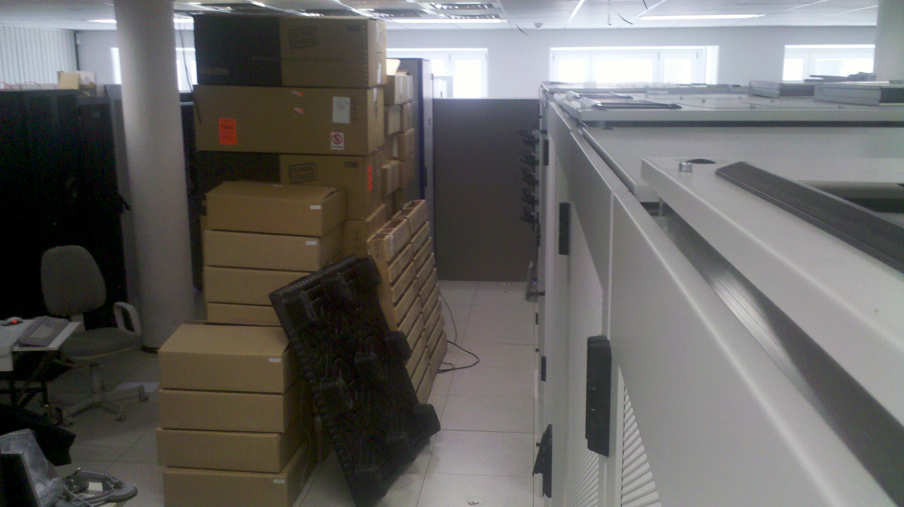
Hardware Setup (4) – DDN Gear
2 x S2A9900 in Dresden
1 x SFA10000 in Freiberg

Slide 8
Sub-Project 2 – Wide Area File Systems
HPC File Systems are expensive and require some human resources
fast access to data is key for an efficient HPC system utilization
technology evaluation as regional HPC center
install and compare different parallel file systems
GPFS

Slide 9
Scenario to get Peak Bandwidth
100GbE
16*8 Gbit/s
16*8 Gbit/s
16*20 Gbit/s DDR IB
5*40 Gbit/s QDR IB

Slide 10
Lustre OSS Server Tasks
OSS NODE
DDR/QDR IB
LNET
routing
From Local Cluster
10 GE
From / To Other Site
FC-8
OSC
OBDFILTER
To DDN Storage

Slide 11
Lustre LNET Setup
idea&picture by Eric Barton
two distinct Lustre networks, one for metadata, one for file content

Slide 12
IOR Setup for Maximum Bandwidth
24 clients on each site
24 processes per client
stripe size 1, 1 MiB block size
Direct I/O
100GbE
21,9 GB/s
Writing to Freiberg
10,8 GB/S
Writing to Dresden
11,1 GB/S
16*8 Gbit/s
16*8 Gbit/s
16*20 Gbit/s DDR IB
5*40 Gbit/s QDR IB

Slide 13
LNET Self Test
IU has been running Lustre over the WAN
As production service since Spring 2008
Variable performance on production networks
Interested in how LNET scales over distance
Isolate the network performance
Eliminates variable client and server performance
Simulated latency in a clean environment
Used NetEM kernel module to vary latency
Not optimized for multiple streams
Future work will use hardware for varying latency
100Gb link provided clean 400KM to test

Slide 14
Single Client LNET performance
LNET measurements from one node
Concurrency (RPCs in flight) from 1 to 32

Slide 15
LNET Self Test at 100Gb
With 12 writers and 12 readers with a ratio of 1:1 we were able to achieve 11.007 Gbyte (88.05%)
Using 12 writers and 16 readers with a ratio of 12:16 we were able to achieve 12.049 Gbyte (96.39%)

Slide 16
IOZONE Setup to evaluate small I/O
100GbE
200km,400km
16*8 Gbit/s
1 Client in Dresden vs. 1 Client in Freiberg (200km and 400km)
small file IOZONE Benchmark, one S2A 9900 in Dresden
how „interactive“ can a 100GbE link be at this distance

Slide 17
Evaluation of Small File I/O (1) – Measurements 200km

Slide 18
Evaluation of Small File I/O (2) – Measurements 400km
measurement error

Slide 19
Evaluation of Small File I/O (3) - Model
observations
up to 1 MB all graphs look the same
each stripe takes a penalty that is close to the latency
each additional MB on each stripe takes an additional penalty
possible model parameters
latency, #rpcs (through file size), penalty per stripe, penalty per MB, memory bandwidth, network bandwidth
best model up to now has only two components:
stripe penalty per stripe, where the penalty time is slightly above the latency
penalty per MB, where penalty time is the inverse of the clients‘ network bandwidth
what can be concluded from that:
client contacts OSS servers for each stripe in a sequential fashion – this is really bad for WAN file systems
allthough client cache is enabled, it returns from the I/O call after the RPC is on the wire (and not after the data is inside the kernel) – is this really necessary?

Slide 20
Conclusion
stable test equipment
Lustre can make use of the available bandwidth
reused ZIH monitoring infrastructure
short tests cycles through DDN port monitor
program traces with IOR events, ALU router events, DDN, etc.
FhGFS reached 22,58 GB/s bidirectional, 12,4 GB/s unidirectional

Slide 21
Fragen?
GPFS

Slide 22
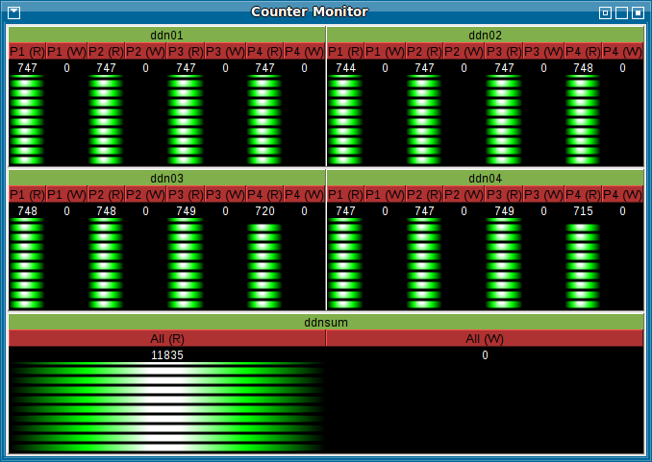
Performance Analyse (1) – DDN Monitor

Slide 23
IOZONE Resultate für 8GB-Dateien und verschiedene Blockgrößen
1 Client in Dresden
mittelgroße Dateien mit dem IOZONE Benchmark
nur eine S2A 9900 in Dresden verwendet

Slide 24
IOZONE Resultate für 16K-Dateien und verschiedene Blockgrößen (Freiberg)
1 Client in Freiberg
Schreiben einer Datei mit variierender Dateigröße zwischen 64KiB und 512 MiB und verschiedenem Striping zwischen 1 und 24, feste Blockgröße von 64KB

Slide 25
Performance Analyse (2) – Infrastruktur-Instrumentierung

Slide 26
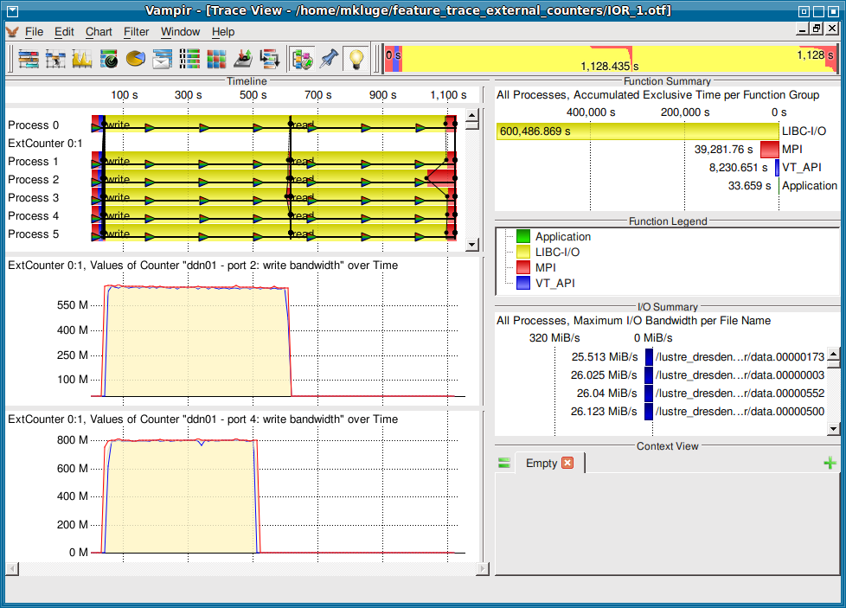
Performance Analyse (3) – Ein Port schneller

Slide 27
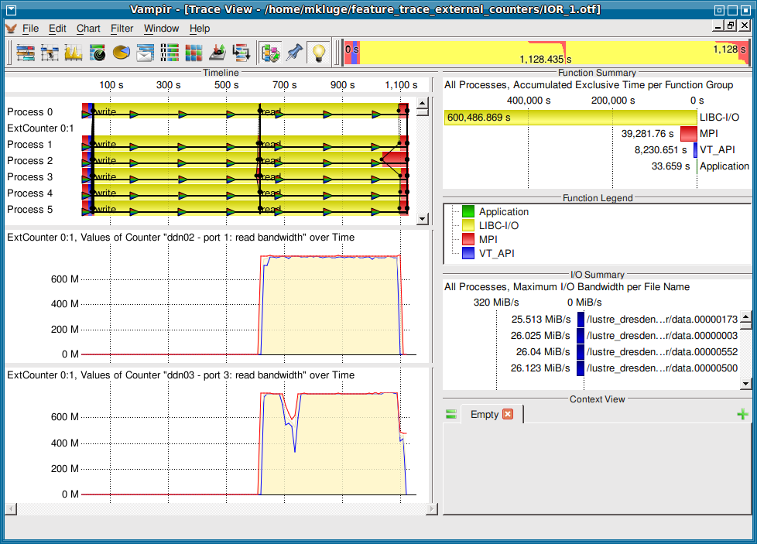
Performance Analyse (3) – Media Error on SATA Disk

Slide 28
Resultat IOR Unidirektional
Reading from Dresden
11,8 GB/s
100GbE
16*8 Gbit/s
16*8 Gbit/s
16*20 Gbit/s DDR IB
5*40 Gbit/s QDR IB

Slide 29
IOZONE Resultate für 16K-Dateien und verschiedene Blockgrößen
1 Client in Dresden vs. 1 Client in Freiberg
kleine Dateien mit dem IOZONE Benchmark
nur eine S2A 9900 in Dresden verwendet

Slide 30
IOZONE Resultate für 8GB-Dateien und verschiedene Blockgrößen
1 Client in Dresden vs. 1 Client in Freiberg
mittelgroße Dateien mit dem IOZONE Benchmark
nur eine S2A 9900 in Dresden verwendet

