Slide 1
Taking aim at ENOSPC: New layouts for an old problem
Self-Extending Progressive File Layouts (SEPFL)

Slide 2
Progressive File Layouts
Allow different layouts for different areas of a file
Rich ground for new features: Data on MDT FLR: Mirroring, erasure coded, etc.
Major improvements to ease of use, performance, reliability, etc.

Slide 3
Pools & Tiering
Pools & tiering are an obvious application of PFLDifferent regions of file on different storage classes (pools)
By default all files use same layout, no recourse if a pool runs out of space
Seems odd but a major concern for some customers

Slide 4
What about ENOSPC?
Traditional Lustre response – Avoid it through improved OST allocation
PFL can help with this by distributing different file regions to different OSTs (basically, smaller allocation “granularity”)
But it’s all static for a given file – If a file is on a set of OSTs and they run out of space, allocation policies can’t help.

Slide 5
Dynamic Layouts
Dynamic layouts: Layouts that change automatically based on system state
Possibilities abound, a lot of them fall foul of “dirty data” problem
Can’t change layout component that client is currently writing to, no mechanism to handle that i/o

Slide 6
Loophole 1: Uninitialized Components
But you can change the extent of components which are not initialized.
Uninitialized “virtual” components which are never init
When i/o hits one of these components, client sends request for layout to the server
Instead of initing the component, the server replaces the needed extent with normal layout space

Slide 7
Loophole 2: Increasing Extents
It is never safe to reduce the extent of an initialized component
But you can increase it by moving the start “up” or the end “down”
When I/O hits a “virtual” component, change the extent of neighboring “real” components to allow the i/o to complete

Slide 8
Self-Extending Layouts
Self-extending PFL (LU-10070)
Some PFL segments are virtual, never instantiated
Request in a virtual segment requires layout update
MDS grants new layout (extend existing component, spillover to trailing, or create new)
Can make choice based on dynamic conditions (e.g. free space)

Slide 9
Self-Extending Layouts

Slide 10
More than Tiering
Tiering is the obvious application, described previously
But there’s a good trick for files without tiering
“Self-spillover” or “spillover restriping”
When the existing OSTs run low on space, create a new component with same striping properties

Slide 11
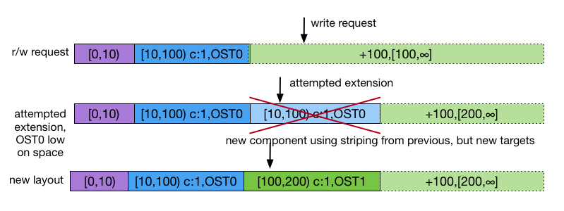
Spillover Restriping

Slide 12
Why not just a better allocator?
Partly orthogonal to improved allocation – It’s still possible to run out of space
Pools of small OSTs need spillover
Also gives the allocator more chances to split files, gives more chances to improve allocation in a badly balanced file system

Slide 13
What about mirror + resync?
Interoperates transparently with mirrors + resync, etc.
Any layout can have self-extending components
Extension policy is just applied before instantiating any components
Works the same for mirrors as regular components

Slide 14
Caveat Emptor
Not perfect, possibly a stop-gap solution
If we could restart i/o on a layout change (very tricky), we could be truly responsive: Only change layout on actual ENOSPC
Group locks don’t work today (requirement to fully instantiate layout)
Append has a similar problem, but should be fixable: LU-9341

Slide 15
Finally:
Any questions?
Happy to answer questions later or by email (paf@cray.com)

